Slide 1

April Showers
🐍CodeX Monthly Project

Slide 2
April Showers
The month of April is known for its rain. Simulate rain on your CodeX, using the accelerometer to start rain showers.
Grab your CodeX
Use the starter program and write some code!

Slide 3
April Showers
Time to code!
Grab your CodeX.
Log in to make.firialabs.com and go to the Sandbox.
Start a new program file and call it April_Showers

Slide 4
April Showers
Starter Program
Some of the code for this project is provided for you.
Open the starter code file for this project.
  April_Showers_starter
Copy and paste the code into your new program file.

Slide 5
April Showers
Starter Code
Run the code to make sure you don’t have any errors.
You should see a the background and some text.
Everything good? Great! Ready to continue…

Slide 6

April Showers
Step 1: Assign values to use with the rain
A function has already been created that draws a single strand of rain.
Call the function in the MAIN PROGRAM so you can see what it looks like.

Slide 7
April Showers
Step 1: Assign values to use with the rain
You should see a little gray line in the upper right corner.
Your goal is to fill the screen going across with little gray lines, and then extend them to the end of the screen to create a simulation of rain.

Slide 8
April Showers
Step 1: Assign values to use with the rain
There are different kinds of rain:
  Light rain, that is spread out and comes down slowly
  Regular rain
  Heavy rain, that is close together and comes down fast

Slide 9
April Showers
Step 1: Assign values to use with the rain
The type of rain will be determined by the amount of CodeX shaking.
  A gentle shake will trigger light rain
  A little shaking will trigger regular rain
  Vigorous shaking will trigger heavy rain

Slide 10
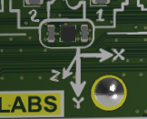
April Showers
Step 1: Assign values to use with the rain
The amount of shaking is read using the accelerometer.
Look on your CodeX below the display screen.
Find the accelerometer. It detects the position in three dimensions.

Slide 11
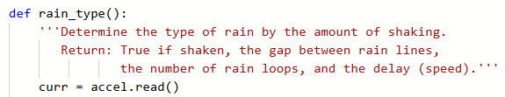
April Showers
Step 1: Assign values to use with the rain
By using a little math, you can calculate the change in position (shaking).
The function that reads the accelerometer and does the math is provided for you.

Slide 12
April Showers
Step 1: Assign values to use with the rain
The first code to add is an if statement selection that will give values for the type of rain:
  is_raining: a Boolean that is either True or False
  gap: How much distance between rain lines
  rain_loops: How many times the rain loop will run
  delay: How fast the rain falls (very small number for fast rain)

Slide 13
April Showers
Step 1: Assign values to use with the rain
Read through the provided code in the function.
It will read the accelerometer every tenth of a second for 20 times and count the changes in position (shaking).
You will add in if..elif..else statement to the function that returns the values for each type of rain.

Slide 14
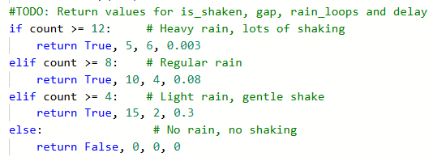
April Showers
Step 1: Assign values to use with the rain
Add this code to the function (you do not need to add the comments):

Slide 15
April Showers
Step 1: Assign values to use with the rain
You can adjust the values for each condition, and the values returned to get the type of rain you want.

Slide 16
April Showers
Step 2: Create a list for the rain
You will use a lot of gray lines to form the rain.
The number of lines depends on the type of rain.
The distance between the lines depends on the type of rain.
Create a list for the position of each gray line.

Slide 17
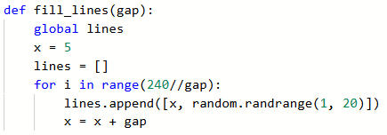
April Showers
Step 2: Create a list for the rain
Add this function to your code, just below the first three functions.

Slide 18
April Showers
Step 2: Create a list for the rain
Let’s examine the code:
Get a random starting height for each line
The first line starts near the left edge
# of lines to create
Start with an empty list
Change the position across the top for each line

Slide 19
April Showers
Step 2: Create a list for the rain
The for loop creates a list of lists.
The beginning of the list might look something like:
First line:
Starts at (5, 19) on the screen.
Second line:
Starts at (20, 9) on the screen.
Third line:
Starts at (35, 3) on the screen.

Slide 20
April Showers
Step 3: Simulate the rain
To see the rain, you need another function.
This function will use an inner for loop to traverse (travel) the list and use its information to draw the lines.
It will also use an outer for loop to draw the lines moving down.

Slide 21
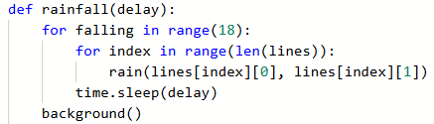
April Showers
Step 3: Simulate the rain
Add this function below the other functions:

Slide 22
April Showers
Inner loop:
Traverses the list and uses the information to draw all the lines across the screen.
Step 3: Simulate the rain
Let’s examine the code
Index:
Which line
[0] is the x
[1] is the y

Slide 23
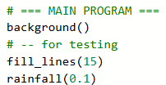
April Showers
Step 3: Simulate the rain
Test the code:
Do you see several gray lines all evenly spaced across the screen?
You can change the arguments in the function calls for further testing.

Slide 24
April Showers
Outer loop:
Repeats the gray lines, moving down the screen to simulate rain.
Step 3: Simulate the rain
Let’s examine the code

Slide 25
April Showers
Step 3: Simulate the rain
But your lines all stayed in the same place!
The lines didn’t move.
You need another function to increment the y values to increase so they move down the screen.

Slide 26
April Showers
Step 4: Incrementing y-values
The list of lists includes an (x,y) ordered pair for each line location.
The x values will stay the same, but each y value needs to increase so the lines are drawn going down the screen.

Slide 27
April Showers
Step 4: Incrementing y-values
Add another function below the other functions.
It will use a for loop to traverse the list, and increment each y value by 10.
Remember: the [1] is the y-value for each ordered pair.

Slide 28

April Showers
Step 4: Incrementing y-values
Add this function:

Slide 29
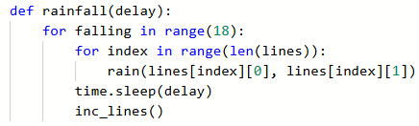
April Showers
Step 4: Incrementing y-values
Call the function in rainfall(). Then run the code again.

Slide 30
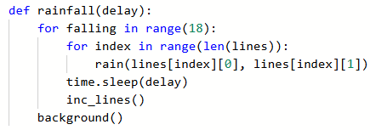
April Showers
Step 4: Incrementing y-values
One more thing. When the rain reaches the ground, you want to start over again.
Call background() at the end of the function.

Slide 31
April Showers
Step 5: Simulating the rain
You have all the functions you need to simulate rain!
The rest of the code will be in the Main Program.
Delete the test code.
The Main Program needs an infinite loop.
Assign values to is_raining, gap, rain_loops and delay by calling the rain_type() function.

Slide 32

April Showers
Step 5: Simulating the rain
Remember: the rain_type() function reads the accelerometer 20 times and then returns values based on the amount of shaking.

Slide 33
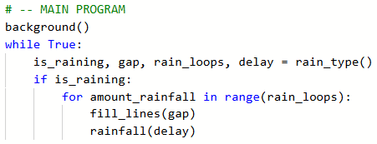
April Showers
Step 5: Simulating the rain
Use the is_raining Boolean in an if statement to call the other functions and simulate rain.
The other values (gap, rain_loops and delay) will be used as well.

Slide 34
April Showers
Step 5: Simulating the rain
Test the code.
Shake the CodeX and see the rainfall.
Use different shakes to see all three types of rain.
Adjust any of the values you want to get the rain just right.

Slide 35

April Showers
Happy Spring!
You have a CodeX simulation of rain!
Next, add May Flowers…

